Slide 1
Final Year Project Presentation
Laura Reddy

Slide 2
Visual Alerting system for Emergency Vehicle Proximity for hear compromised drivers
The aim of this project is to create a way for people who are deaf or who are wearing head protection to be more aware of emergency vehicles that are approaching them.
This involves detecting the sounds and then comparing them to the specific characteristics of the different sirens to lower the chances of false alarms going off.

Slide 3
Visual Alerting system for Emergency Vehicle Proximity for hear compromised drivers cont.
Once the siren has been detected it should start a led flashing so that the driver will be aware of the presence of the emergency vehicle.
The system will have to be battery operated so that it can easily be placed on the dash board of a car or on a motorbike.
The system will also have to have a method of turning on and off so that the user can turn it off while they are not driving to help with power consumption.

Slide 4
Garda Sirens
The Gardaí have two different sirens that they use to let drivers know that they are approaching.
The 1st siren is the one that they would use while driving in busy traffic or trying to get someone to pull over.
The 2nd siren is the one that they use if they are approaching a busy intersection and they need to let people know that they are trying to get through.
I have taken sample recordings of both of these sirens.

Slide 5
Matlab
I have used Matlab to get graphs of these sirens.
I have saved the results from reading the siren into Matlab into a text file called outFile.
I have also tried to do some Fourier analysis on both of these sound waves.
The graphs for the Fourier analysis are not coming out like sin waves they are coming out like strange circles when I just use the plot() but if I use the semilog() command the results come better for the 1st siren but they disappear for the 2nd siren.

Slide 6
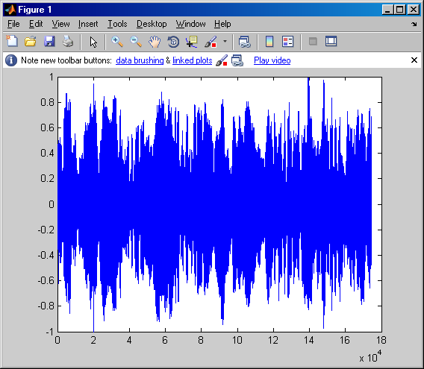
Graph of 1st Garda Siren

Slide 7
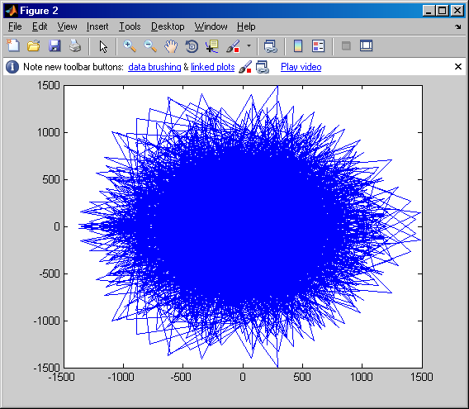
Graph of Fourier analysis on the 1st Siren using plot()

Slide 8
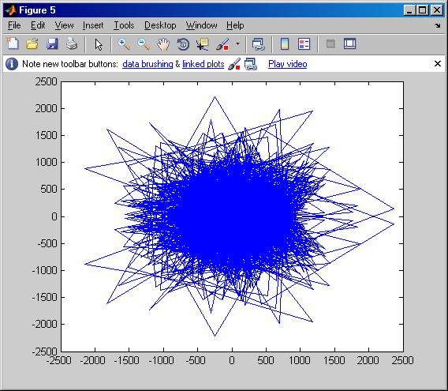
Graph of Fourier analysis on the 2nd Siren using plot()

Slide 9
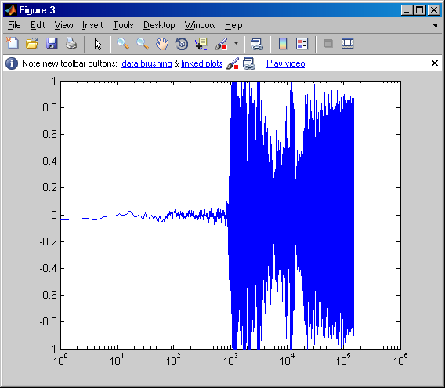
Graph of Fourier analysis on the 1st Siren using semilog()

Slide 10
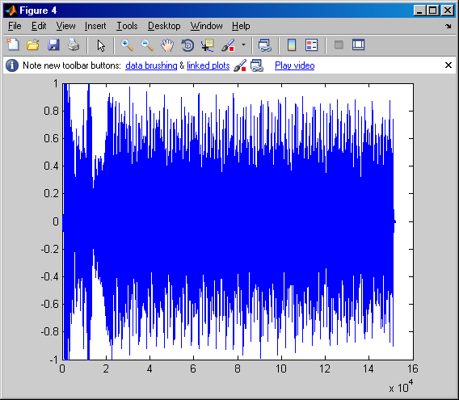
Graph of 2nd Garda Siren

Slide 11
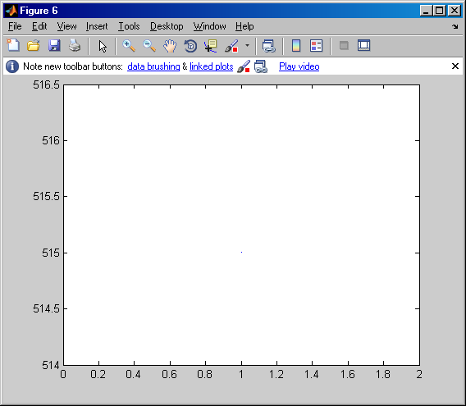
Graph of Fourier analysis on the 2nd Siren using semilog()

Slide 12
Work done
I used two methods to try and get the output of the Fourier transform to look like a sin wave.
The 1st one just plots the result of the fft() function.
The 2nd one was the same as the method we were shown in the tutorial yesterday but that keeps throwing an error that the vectors are not the same length, they should be as one value is determining the other. (Ts = 1/Fs)

Slide 13
Work to be done
I have to see why neither method I used to get the Fourier transform worked correctly.
Once I have the determined the values of frequencies for each of the sirens I will have to write code to compare an input signal to these values to establish whether the input is the same as one of the Garda signals.
I will also have to get sample recordings of the sirens that the fire brigade & the ambulances use so that they can be integrated into the system as well.

Slide 14
Matlab code
% Laura Reddy 06608523
% Code to do fourier analysis on Garda sirens
clear all;
close all;
clc
[x fs bits] = wavread('E:\Final Year Project\Laura\GardaSiren1.wav');
outFile = fopen('outFile.txt', 'w');
fprintf(outFile, '%f\n', x);
fclose(outFile);
ts = 1/fs;
t = 0:ts:0.5-ts;

Slide 15
Matlab code cont
X = fft(x);
X1 = semilogx(x);
figure(1);
plot(x);
figure(2);
plot(X);
figure(3);
plot(X1);
abs(x)

Slide 16
Matlab code cont.
%plot(t,x);
%grid on;
% % get fft of the signal
%fftOfSignal1 = fft(x,1024);
% % looking at positive sides only
%fftOneSided1 = fftofSignal1(1:512);
% % getting the frequency axis
%df = (fs/2)/511;
%freqAxis = 0:df:fs/2;
%figure(2);
%plot(freqAxis,abs(fftOneSided1));
%xlabel('frequency (Hz) ');

Slide 17
Matlab code cont.
%ylabel('Amplitude (db) ');
%hold on;
%grid on;
%figure(3);
%plot(freqAxis,20*log10(abs(fftOneSided1)));
%xlabel('frequency (Hz) ');
%ylabel('Amplitude (db) ');
%hold on;
%grid on;
% Siren 2
[y fs bits] = wavread('E:\Final Year Project\Laura\GardaSiren2.wav');
outFile = fopen('outFile2.txt', 'w');

Slide 18
Matlab code cont
fprintf(outFile, '%f\n', y);
fclose(outFile);
Y = fft(y);
Y1 = semilogx(y);
figure(4);
plot(y);
figure(5);
plot(Y);
figure(6);
plot(Y1);
abs(y)

Slide 19
Matlab code cont.
%plot(t,x);
%grid on;
% % get fft of the signal
%fftOfSignal1 = fft(x,1024);
% % looking at positive sides only
%fftOneSided1 = fftofSignal1(1:512);
% % getting the frequency axis
%df = (fs/2)/511;
%freqAxis = 0:df:fs/2;
%figure(5);

Slide 20
Matlab code cont.
%plot(freqAxis,abs(fftOneSided1));
%xlabel('frequency (Hz) ');
%ylabel('Amplitude (db) ');
%hold on;
%grid on;
%figure(6);
%plot(freqAxis,20*log10(abs(fftOneSided1)));
%xlabel('frequency (Hz) ');
%ylabel('Amplitude (db) ');
%hold on;
%grid on;
%[y fs bits] = wavread('E:\Final Year Project\Laura\GardaSiren2.wav')
%X = fft(x)

Slide 21
Matlab code cont.
%X1 = semilogx(x)
%Y = fft(y)
%Y1 = semilogx(y)
%plot(x)
%plot(y)
%abs(x)
%abs(y)

Slide 22
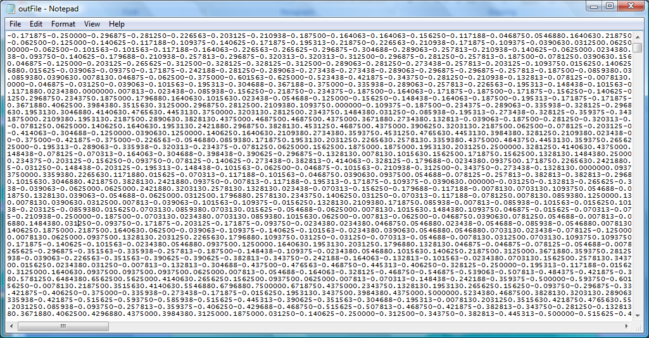
Sample output of Fourier analysis on 1st siren

Slide 23
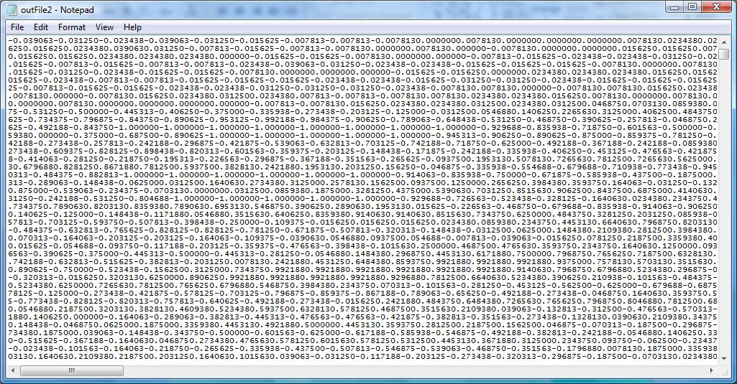
Sample output of Fourier analysis on 2nd siren

